Slide 1
Sentiment Analysis for the customer reviews on Zomato
By,
BALAKIRAN Manthri
Kiran Sai Taneeru
Kailash Choswdary Bodduluri

Slide 2
INTRODUCTION
The main aim of this project is to analyze the reviews given by the customer for the restaurants in Bangalore on a public platform-Zomato.
Firstly, we analyzed the patterns between the variables rate and cost for two and we also tried to find the best location for a new restaurant based on the dishes they offer.
For finding the best location we measure sentimental values of the customer reviews on restaurants and services.
We also used classifiers to classify the reviews which produce different classification results and for predicting the rating in the dataset study, we have used decision tree algorithm.

Slide 3
DATASET
The dataset is taken from Kaggle which has 17 different attributes i.e. url, address, name, online_order book_table, rate, votes, phone, location, rest_type, dish_liked, cuisines, approx._cost(for two people) -- average_cost, reviews_list, menu_item, listed_in(type) – restaurant_type, listed_in(city)--locality.
The mainly used attributes of all among 17 are as follow:
• Online_order – The column consists of Yes or No values, where it is Yes if the delivery is available and No if not.
• Rate – This column consists of float values which are given by the customer as rating for the restaurant and ranges from 1 – 5.
• Location – Location column consists the locality of restaurant.
• Restaurant_type – This column consists the type of the restaurant.

Slide 4
METHODOLOGY
Data Handling- Initially the data is loaded into dataframe using python. The irrelevant attributes are removed and renamed, cleaned the attributes average_cost and rate, null values are removed, and the average_cost and rate are converted from string to float.
Exploratory Data Analysis- We analyzed what kind of food and restaurant the customer would prefer to pick and we also anlayzed how the customer preferences and cost will effect the rating.
Natural Language Processing- Data cleaning is the standard step used in Natural Language Processing (NLP) such as cleaning the text like removing punctuations, stop words, special characters, and word tokenization.

Slide 5
METHODOLOGY
Training and Testing Datasets- For both mutinomial Naïve Bayes and decision tree algorithm we divided the data into two parts, 80% of data as training data and 20% of data as testing data.
Techniques Performed- We used Multinomial Naïve Bayes classifier under SKLEARN package in python for training and testing the model for the sentiment scores and we used Decision Tree under SKLEARN package in python for training and testing the model for prediction of rating in the dataset.

Slide 6
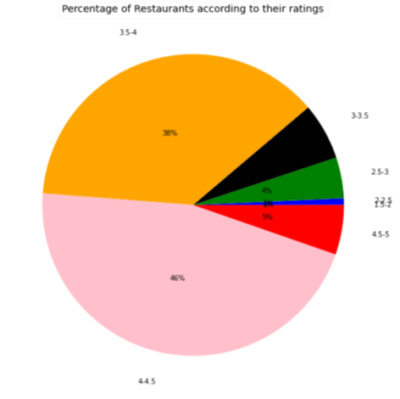
DATA EXPLORATION
The data is investigated and the conclusions are drawn form the graphs, which are developed from the dataset.
Online order and Table Booking services- If figure-1 is observed, 70% of the customer are preferring to order the food online. And if the remaining 30% of customers are made to a 100 percentile 26% of customers are preferring to book a table.
Percentages of Restaurants based on Ratings- From figure-2 plot we can conclude that 46% of the restaurants are been rated between 4-4.5 and only 5% of the restaurants are rated more than 4.5.
Figure-1
Figure-2

Slide 7
DATA EXPLORATION
Restaurant Types- Plot in figure-3 shows the top 20 restaurant types and we can conclude that Casual Dining and Quick Bites are at the top.
Top Rating Restaurants- The figure-4 shows the top 5 restaurants with rating more than 4.5 and the average cost is 3000INR for two people. Figure-5 shows the restaurants with rating more than 4.5 and the price less than 500INR.
Figure-3
Figure-4
Figure-5

Slide 8

RESULTS * We used Decision Tree as the preferred algorithm and predicted the rating column with the accuracy of 83%. * By using sentiment analysis tools we ranked the sentiment of the reviews and converted the score to Positive (if it is greater than 0), Neutral (if it is equal to 0) and Negative (if less than zero). * From figure 6 we can observe that we predicated the sentiment scores based on the reviews and sentiments based on the sentiment score.
Figure-6

Slide 9
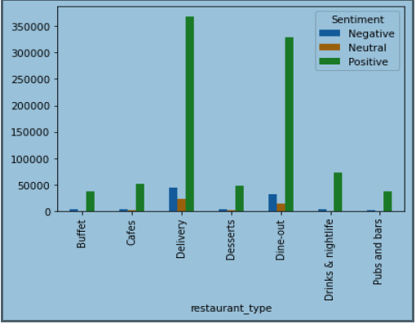
From Figure-7 we can conclude that the Restaurants offering delivery has the most Positive reviews when compared with other types of restaurants.
Figure-7

Slide 10
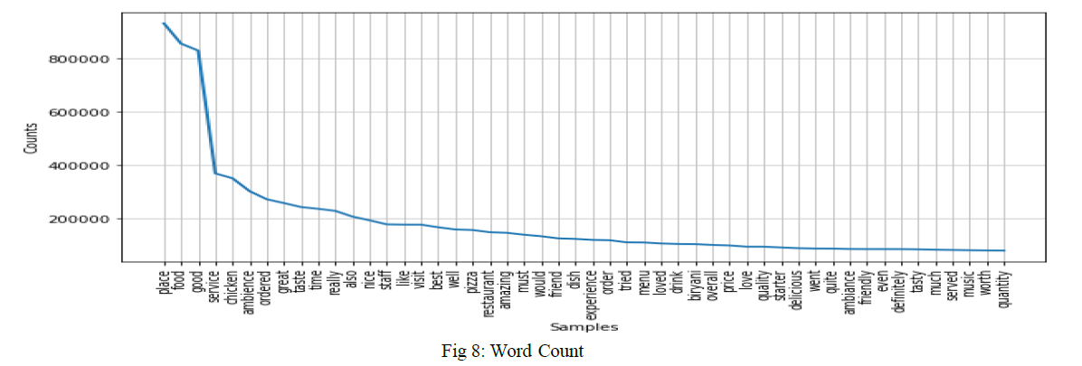
* For finding the count we tokenized the words, removed all stop words and lemmatized the words which can be used for finding the most used words in reviews. * From figure-8 we can see the word count of the top words which are used in reviews. In reviews people are usually talking more about the place, service, food and ambiance. From which we can assume that having a good place, service and ambiance would be attracting the people towards the restaurant.
Figure-8
Fure-8

Slide 11
RESULTS
We predicted the sentiment scores using the Multinomial Naïve Bayes and we achieved an accuracy of 82% for the dataset.
Based on our study and assumptions, we suggest to choose North Indian as your top cuisine and Paratha as your top dish, if you are planning to open a restaurant in BTM Layout. In the same way, If you are an expect in making Biriyani you can choose Banaswadi, Bannerghatta Road as your preferred locations to open your restaurant.
Based on restaurant type one can choose to establish a new restaurant at different location based on which risk type one belongs to . One can choose the common dish as a risk averse and can go with a new dish as a risk prone.

Slide 12
DISCUSSIONS AND LIMITATIONS
From the results we tried to find the best location for establishing a restaurant based on the customer reviews and we also predicted the rating of the restaurant.
The results which are obtained can be an assumption based on our analysis and study, there may also be different perspectives and ideologies.
The assumptions and results are given unbiasedly, we tried to study the dishes liked by the customers, rating given to the restaurants, and the location of the restaurant.

Slide 13

.
THANK YOU

